Slide 1
Sales Financial Dashboard
Interactive Power BI Dashboard
Prepared on: June 26, 2025

Slide 2
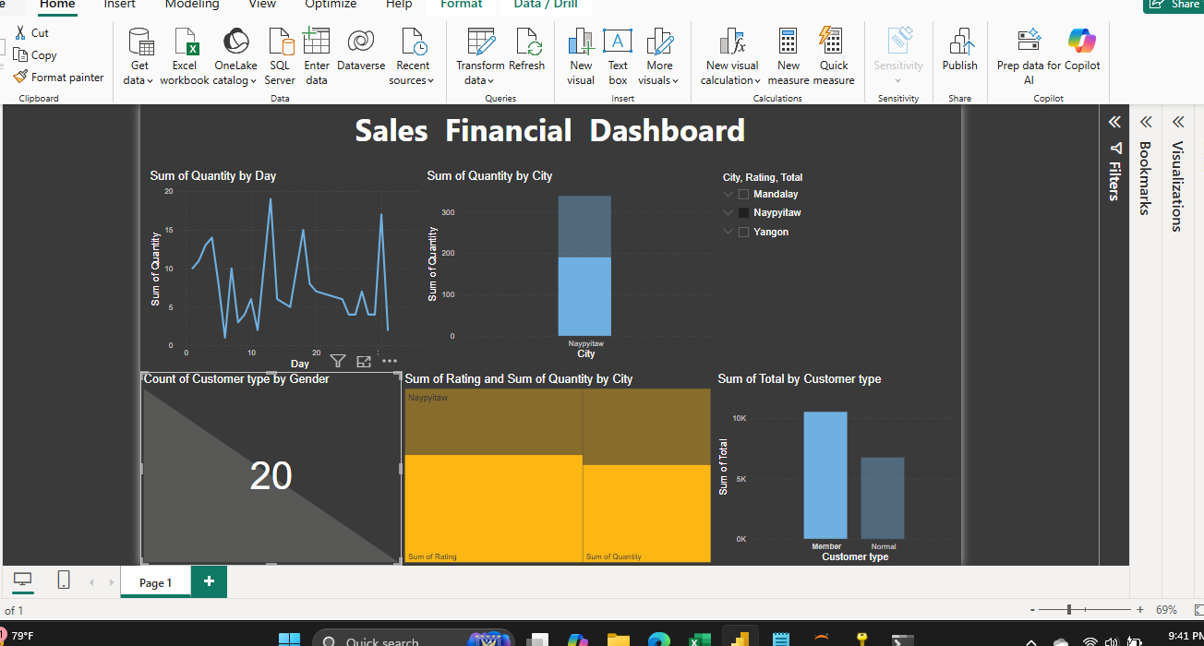
Dashboard Overview

Slide 3
Key Insights from Dashboard
- 📈 Daily sales fluctuate with visible peaks.
- 🏙️ Naypyitaw leads in quantity sold.
- 👥 Customer type by gender count = 20.
- 📊 Treemap compares Rating vs Quantity by city.
- 🧾 Member customers generate more sales than Normal.

Slide 4
Dashboard Features & Visuals
- Slicers for city, rating, and total filters.
- Line chart: Quantity by Day (trend analysis).
- Bar charts: City-wise and customer-type sales.
- Card visual: Customer type count by gender.
- Treemap: Combined view of rating and quantity.
- Consistent dark theme for readability.

Slide 5
Recommendations
- Promote underperforming cities like Mandalay.
- Target normal customers to convert them to members.
- Add profit and margin visuals for full financial insights.
- Use drill-through to analyze top customer/product segments.

